Slide 1
Lempel-Ziv-Welch (LZW) Compression/Decompression
Shaun Holtzman
Travis Wise

Slide 2
Summary
Introduction
What is LZW Compression?
Compression
Decompression
Hardware & Design Tools
Goals
Tasks Breakdown
Similar Work
Introduction
What is LZW Compression?
Hardware & Design Tools
Goals
Tasks Breakdown
Similar Work
Notes:
Shaun

Slide 3
Introduction
Shaun Holtzman
2nd semester Master’s student
University of Florida transfer
VHDL experience:
UF Classes: Digital Logic, Digital Design, Reconfigurable Computing
Travis Wise
2nd semester Master’s student
University of Florida transfer
VHDL experience:
UF Classes: Digital Logic, Digital Design, Reconfigurable Computing
Work Experience: Performance analysis of FPGAs
Introduction
What is LZW Compression?
Hardware & Design Tools
Goals
Tasks Breakdown
Similar Work
Notes:
Both

Slide 4
What is LZW Compression?
Universal lossless data compression algorithm
Created by Abraham Lempel, Jacob Ziv, and Terry Welch
Algorithm of the widely used Unix file compression utility compress
Used in the GIF image format
Uses a ‘dictionary’ to compress data
Introduction
What is LZW Compression?
Hardware & Design Tools
Goals
Tasks Breakdown
Similar Work
Notes:
Shaun

Slide 5
Compression
Consists of five major steps
Initialize the dictionary to contain all strings of length one
Find the longest string W in the dictionary that matches the current input
Emit the dictionary index for W to output and remove W from the input
Add W followed by the next symbol in the input to the dictionary
Go to step 2
Introduction
What is LZW Compression?
Hardware & Design Tools
Goals
Tasks Breakdown
Similar Work
Notes:
Shaun

Slide 6
Decompression
Reads a value from the encoded file, outputs the corresponding string from the dictionary
Dictionary needs to be rebuilt first
This part of the algorithm is performed the same way as the encoding process
To do this, we read in character data and find the longest string that matches the current input
Add the current string and the next character to the dictionary
Introduction
What is LZW Compression?
Hardware & Design Tools
Goals
Tasks Breakdown
Similar Work
Notes:
Travis

Slide 7
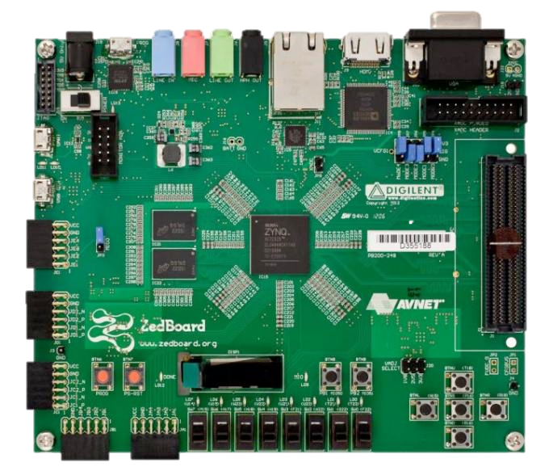
Hardware & Design Tools
ZedBoard
Zynq-7000 ARM/FPGA SoC Development Board
Dual Cortex-A9 Processing System
Zynq-7020 Processor
Artix-7 FPGA
Design Tools
Vivado
Xilinx SDK
Introduction
What is LZW Compression?
Hardware & Design Tools
Goals
Tasks Breakdown
Similar Work
Notes:
Travis

Slide 8
Goals
Conservative goals
Compress text coming from an already initialized RAM
Implement decoder in software and shoot for high speed encoding in hardware
Optimistic goals
Have input text come through the Zynq Processing System
Parallelize the encoder’s dictionary search for faster encoding
Introduction
What is LZW Compression?
Hardware & Design Tools
Goals
Tasks Breakdown
Similar Work
Notes:
Shaun

Slide 9
Tasks Breakdown
Software implementations
Compression & decompression
Start with independent design in C that reads a text file and does compression/decompression
Draw up architectural block diagram of hardware design for compression
Use software implementation to help decide functional blocks that are needed
Implement compression in hardware
Implement decompression in software on the board
Implement communication between Zynq Processing System and compression hardware if time permits
Introduction
What is LZW Compression?
Hardware & Design Tools
Goals
Tasks Breakdown
Similar Work
Notes:
Shaun

Slide 10
Similar Work
Wei Chui, “New LZW Data Compression Algorithm and its FPGA Implementation”
Modified version of LZW
Has 8 dictionaries operating in parallel
Compresses at 198.4 MB/s
Saud Naqvi, “Optimized RTL design and implementation of LZW algorithm for high bandwidth applications”
Fixed width strings in dictionary
4 dual-port BRAMs to allow parallel searches
1 GB/s throughput
Introduction
What is LZW Compression?
Hardware & Design Tools
Goals
Tasks Breakdown
Similar Work
Notes:
Travis

Slide 11
Questions?

